Slide 1
SHARK are our friends
head().underwater

Slide 2
The original dataset aka the nightmare
Dataset size : 6965 rows x 23 columns
Final size : 6355 x 18
Reporting from various sources about shark related incidents all over the world
6965 incidents from 1823 to 2024
Different sources mean different reporting methods that are not uniformized
Our mission : clean the dataset to draw relevant conclusions for our business.

Slide 3
Our hypothesis
We should focus on countries where surfing is highly practiced, as shark attacks are mostly on surfers.

Slide 4
WHO ARE WE ?
head().underwater
Productors of smart jewelry that can detect shark movements and species, emitting signals to alter the shark’s behavior.
Market entry strategy
We have decided to focus mainly on surfing countries that experience many shark attacks

Slide 5
SHARK ILLEGAL FISHING
USA
MEXICO
AUSTRALIA
BAHAMAS
NEW CALEDONIA
BRAZIL
NEW ZEALAND

Slide 6
MAIN DIFFICULTIES
Pivot table mask
Import CSV
Null management
Live coding

Slide 7
Exploratory data analysis
Value_counts()
isna()
Identify and understand the number of rows per category
At least 25 na per column
nunique()
shape/columns
Use of Excel
Verification of the success of our cleanings
Change the name of the columns and identify the shape of the dataset
Identification of the fatality column

Slide 8
Major problem : na management
isna()
isinstance()
df.dtype
Function creation

Slide 9
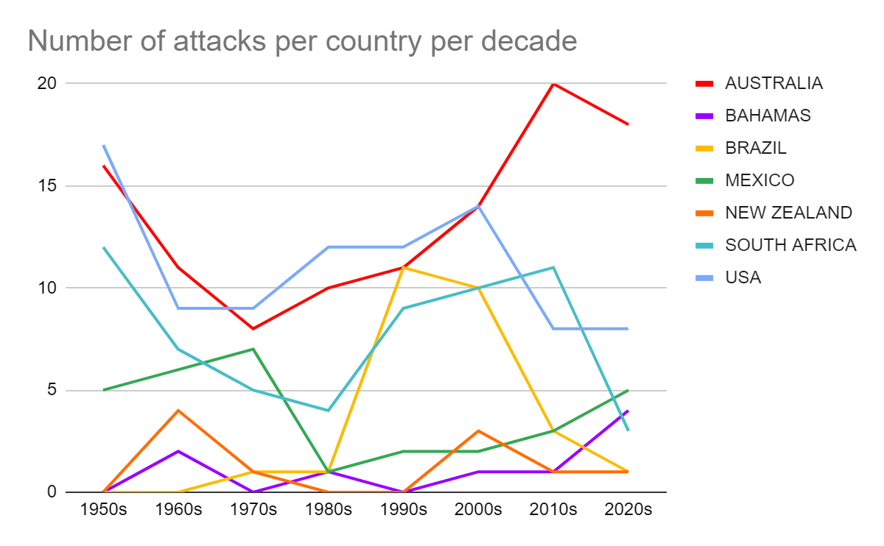
Deaths per species per country

Slide 10
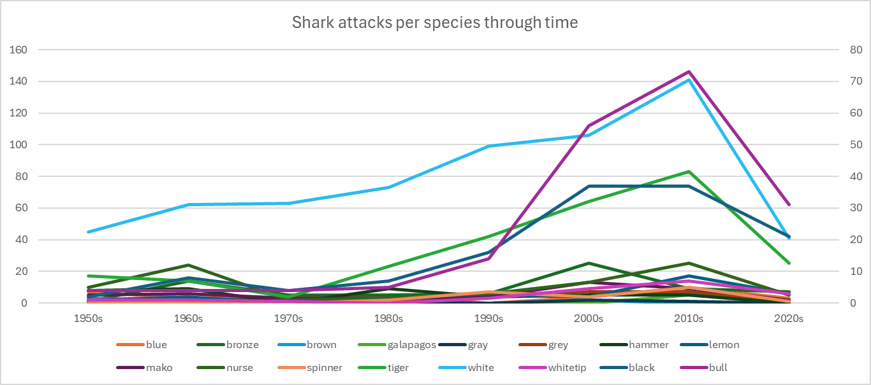
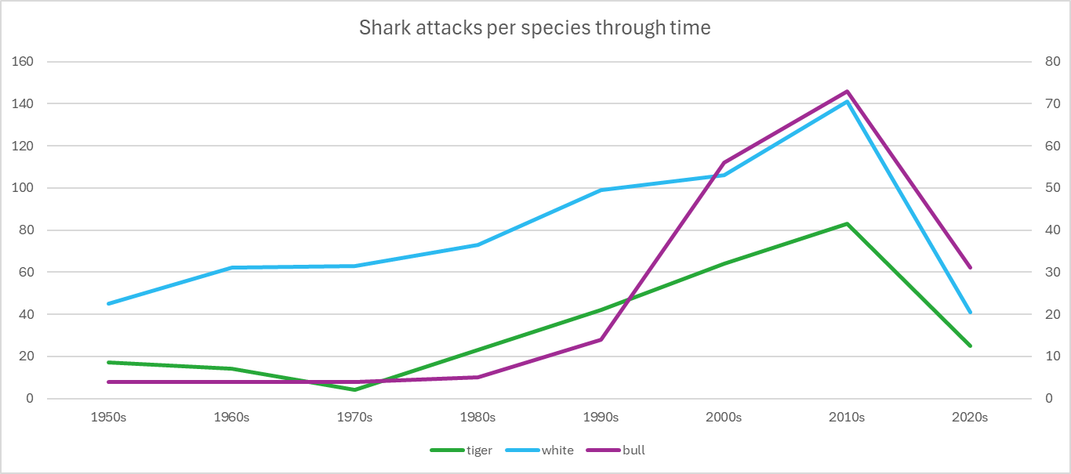
Deaths per species per country
46% of fatalities are caused by white sharks & 46% of deaths happen in Australia

Slide 11
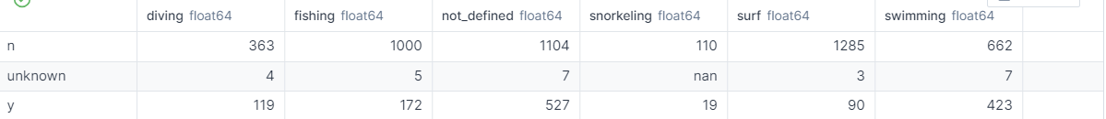
Deaths per activity
31% of fatalities are caused while swimming
8% of fatalities are caused while diving
6% of fatalities are caused while surfing while being the most attacked
13% of fatalities are caused while fishing
N = Survived
Y = Died

Slide 12
Our decision
Swimmers
Australia
Most death count
Shark attacks number was rising in the past few decades
Surfers
Prevention
Not the most killed but most attacked
Prevention before implementing in Australia

Slide 13
THANKS!
DO YOU HAVE ANY QUESTIONS?

